Slide 2
Students will be able to:

Slide 3
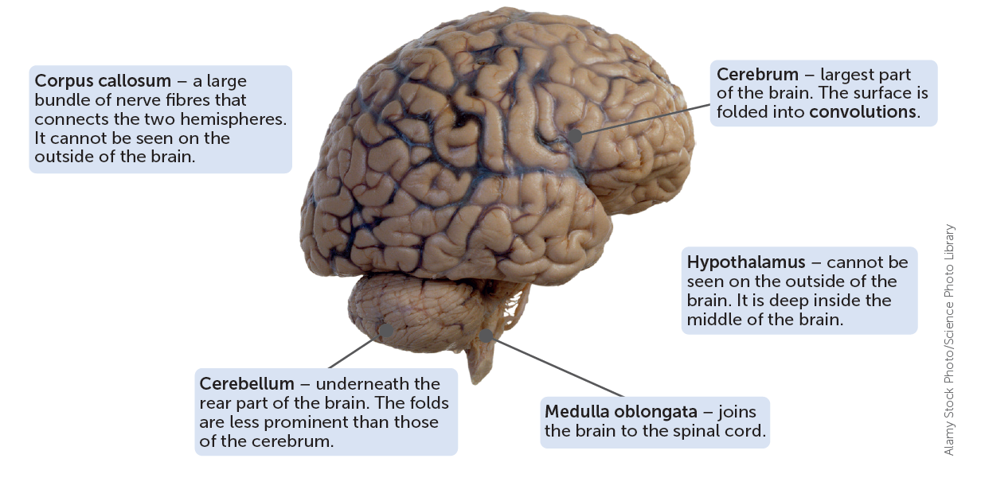
The Brain
The brain is a very complex organ, both in structure and function. Much of the brain's workings are still a mystery and new discoveries are constantly being made in this section we will deal only with those parts of the brain that have major functions, but it is important to remember that the brain works as an integrated whole.
Notes:
Teacher Cue – refer to the vocabulary box as you read through and “unpack” the definition provided. Use hand gestures to emphasise the ”2 or more”, “mixed” and “separated” parts of the definition.
Have students complete CFU 1 as a pair-share, then record these definitions & examples as notes (with diagrams) if desired.
CFU 2 – pair-share, then whiteboards for answers – call on non-volunteers.

Slide 4
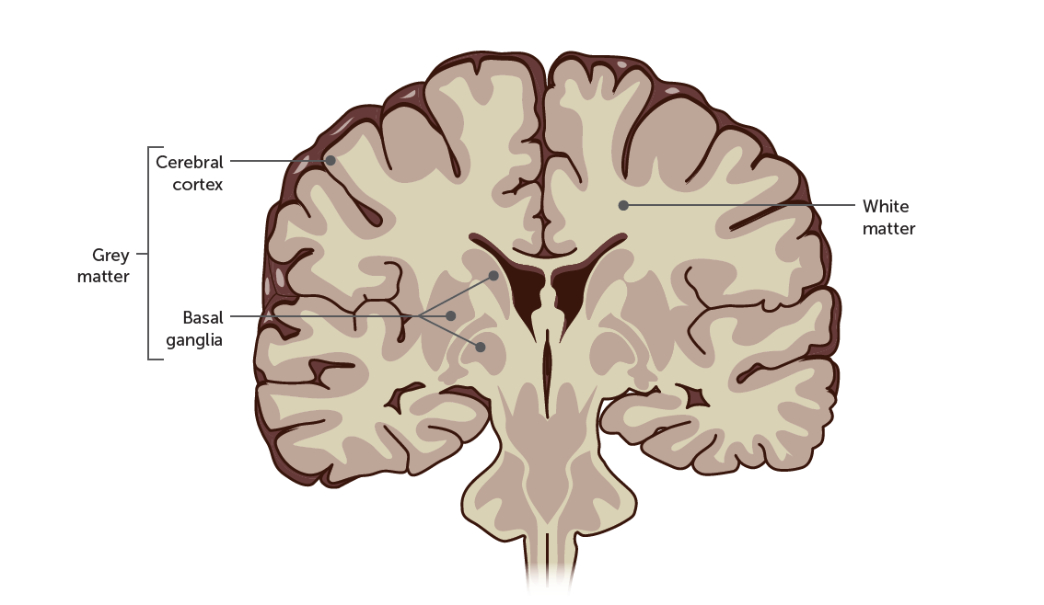
Cerebrum
The cerebrum is by far the biggest part of the brain. It consists of an outer surface about 2-4 mm thick of grey matter known as the cerebral cortex. The grey matter consists of neuron cell bodies dendrites and unmyelinated axons Below the cortex is white matter, which is made up of myelinated axons. The fatty nature of myelin gives the white matter its colour and texture. Deep inside the cerebrum is additional grey matter called the basal ganglia.
Notes:
CFU – read through the slide, have students look closely at the diagram, then allow think time, before asking them to explain it to their partner using the key terms pure substance and mixture. Call on non-volunteers and provide feedback, encouraging detailed responses in full sentence form.

Slide 5
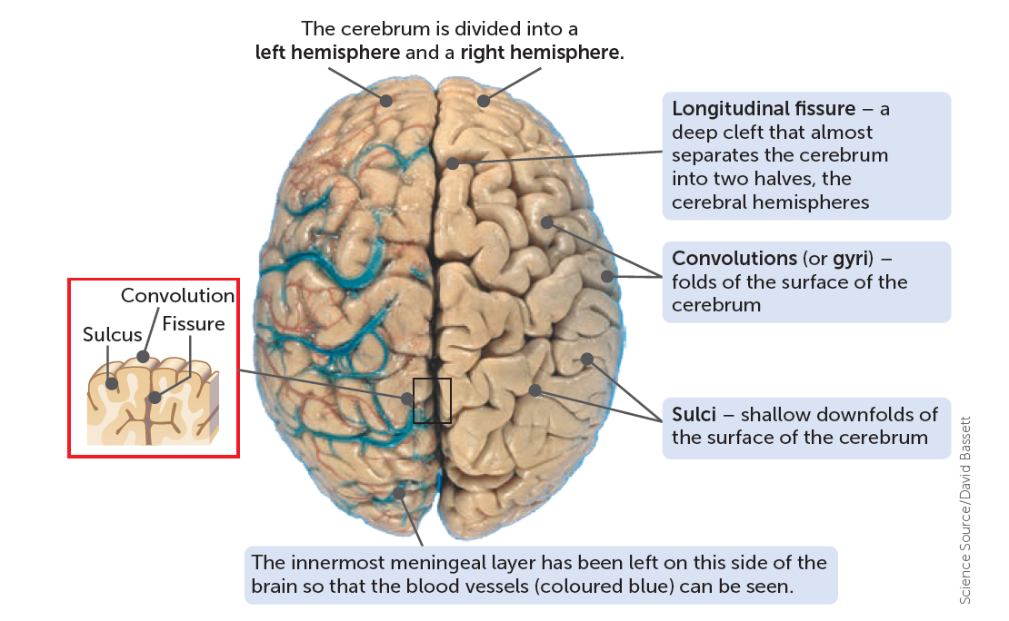
Cerebrum
The cortex contains 70% of all the neurons in the central nervous system. The folding produces rounded ridges called convolutions (or gyn: singular: gyrus). The convolutions are separated by either shallow downfolds called sulci (singular sulcus) or deep downfolds called fissures.

Slide 6
Cerebrum
The deepest fissure, the longitudinal fissure, almost separates the cerebrum into two halves - the left and right cerebral hemispheres. Joining the two hemispheres, at the base of the longitudinal fissure, is an area of white matter consisting of a large bundle of transverse fibres known as the corpus callosum. The patterns of folding of the cerebral cortex. vary from person to person.

Slide 7
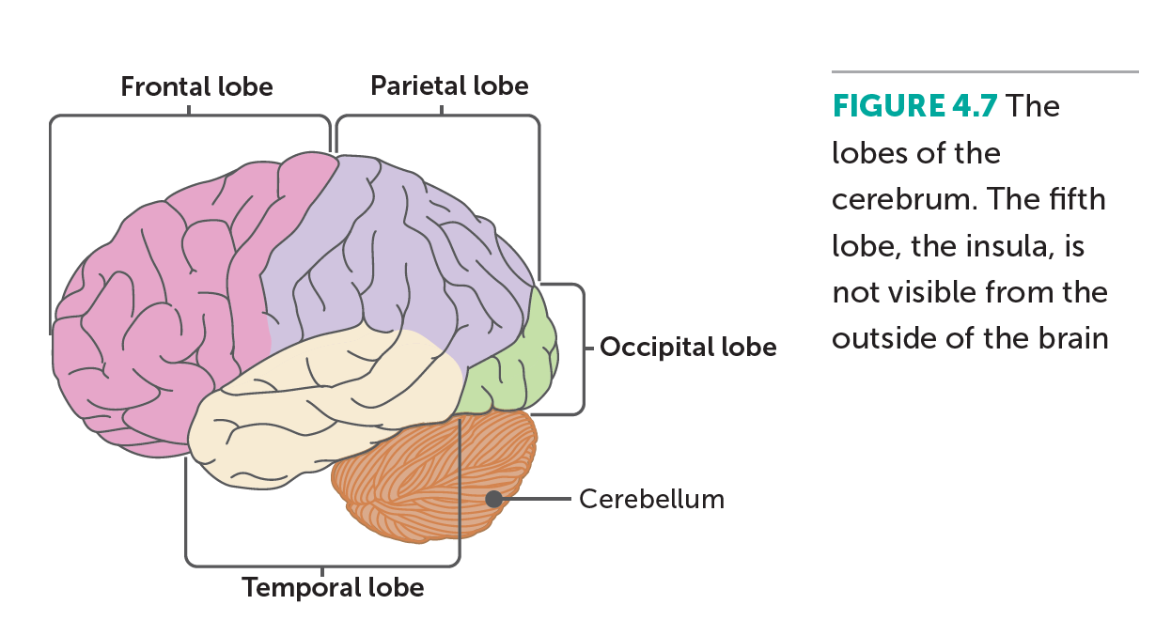
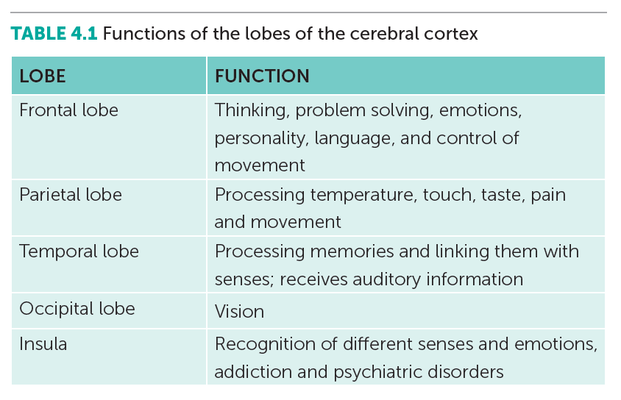
Cerebrum

Slide 8
Cerebrum
However, certain fissures and sulci are fairly constant and are used to further subdivide each cerebral hemisphere into four lobes - the frontal, temporal, occipital and parietal lobes. Another part of the cerebrum, the insula, is deep inside the brain and is regarded as a fifth lobe.
The cerebral cortex is involved in mental activities such as thinking, reasoning, learning, memory, intelligence and sense of responsibility it is also concerned with perception of the senses and the initiation and control of voluntary muscle contraction. Nearly all the impulses from our sense organs are carried to the cerebral cortex, which then has all the relevant information about the environment and can initiate responses accordingly.

Slide 9
Cerebrum
The cortex can be roughly divided into three:
Sensory areas, which interpret impulses from receptors.
Motor areas, which control muscular movements.
Association areas, which are concerned with intellectual and emotional processes.

Slide 10
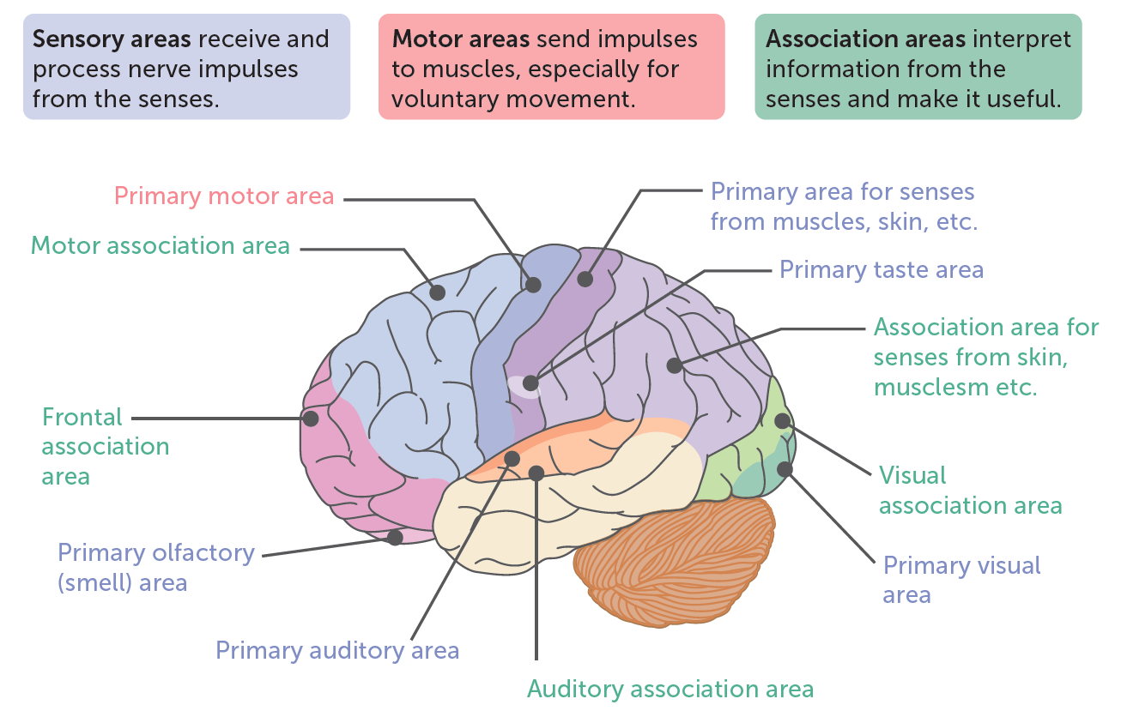
Cerebrum
Although the two sides of the cerebrum appear to be very similar, close inspection shows that they are not identical For example in right-handed people the night frontal lobe is wider than the left and the left occipital and parental lobes are wider than the right ones Many specialised functions occur in only one hemisphere Language ability for example, is normally controlled by the left hemisphere: musical and artistic abilities are functions of the right hemisphere.

Slide 11
Cerebrum
Between the cerebral cortex and the basal ganglia is white matter composed of bundles of nerve fibres that are surrounded by a sheath of white fatty material called myelin. Within the CNS. bundles of nerve fibres are called tracts; outside the CNS they are called nerves:
Three types of tracts occur in the white matter:
Tracts that connect various areas of the cortex within the same hemisphere.
Tracts that carry impulses between the left and right hemispheres.
Tracts that connect the cortex to other parts of the brain or to the spinal cord.
The basal ganglia consist of groups of nerve cell bodies associated with control of skeletal muscles. They play a role in initiating desired movements and inhibiting unwanted movement.

Slide 12
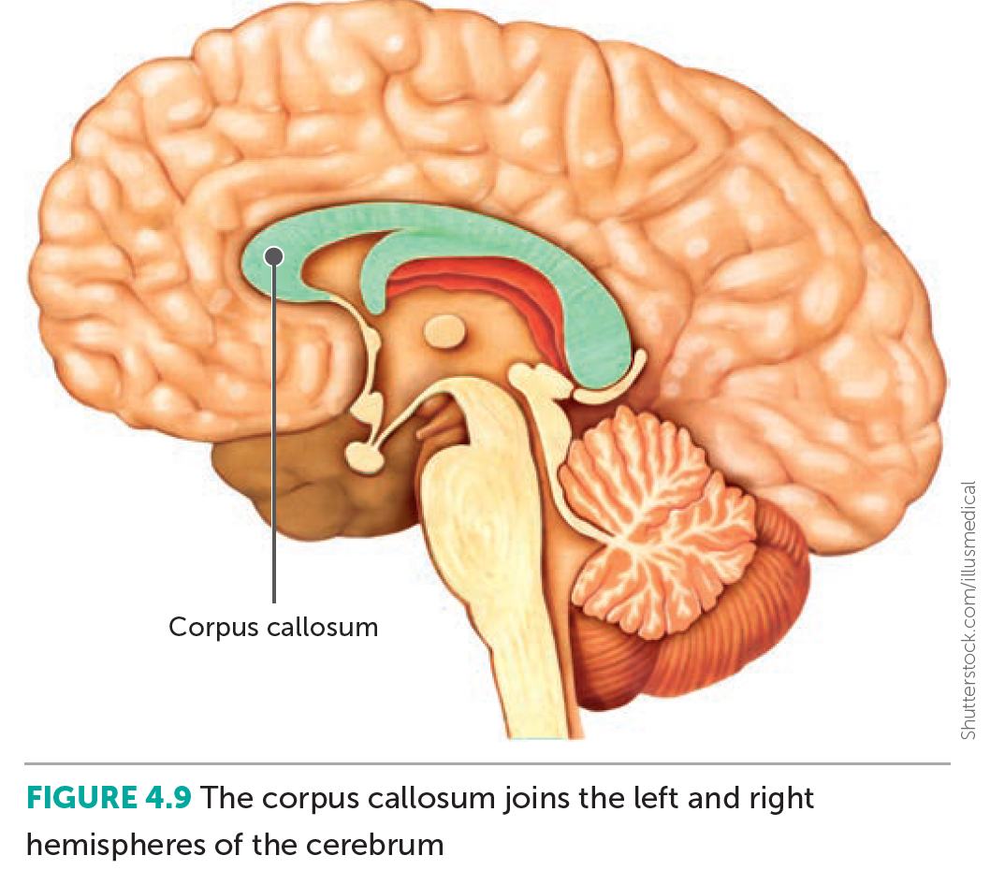
Corpus callosum
The corpus callosum is a wide band of nerve fibres that ties underneath the cerebrum at the base of the longitudinal fissure. Nerve fibres in the corpus callosum cross from one cerebral hemisphere to the other and allow the two sides of the cerebrum to communicate with each other.

Slide 13
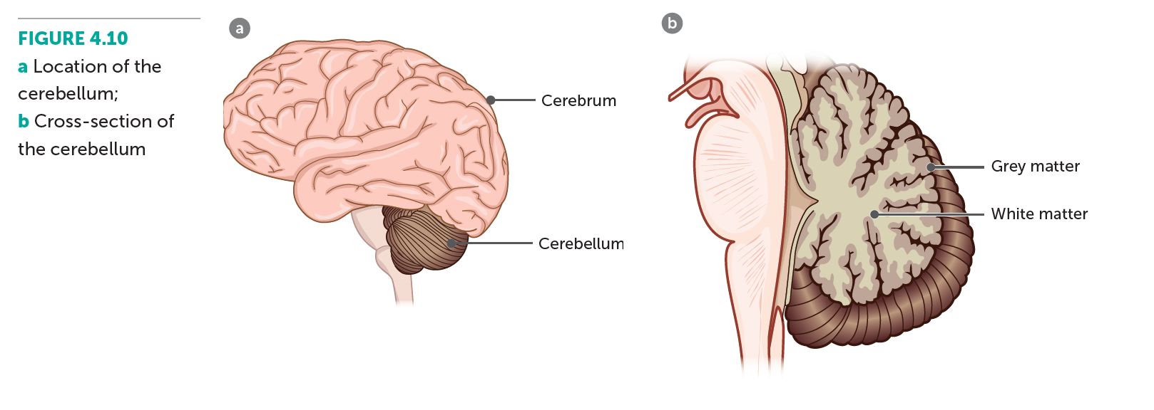
Cerebellum
The cerebellum lies under the rear part of the cerebrum. It it the second largest part of the brain and its surface is folded into a series of parallel ridges. The outer folded part of the cerebellum is grey matter inside is white matter that branches to all parts of the cerebellum rather like the branches of a tree.

Slide 14
Cerebellum
The cerebellum exercises control over posture, balance and the fine coordination of voluntary muscle movement. To carry out these functions the cerebellum receives sensory information from:
The inner ear for information about posture and balance
Stretch receptors in the skeletal muscles for information about the length of muscles.
All the functions of the cerebellum take place below the conscious level. Impulses do not originate in the cerebellum and so without it we could still move, but our movements would be spasmodic. jerky and uncontrolled. Smooth, coordinated movements, such as those required for writing, playing a musical instrument or using a computer, would be impossible.

Slide 15
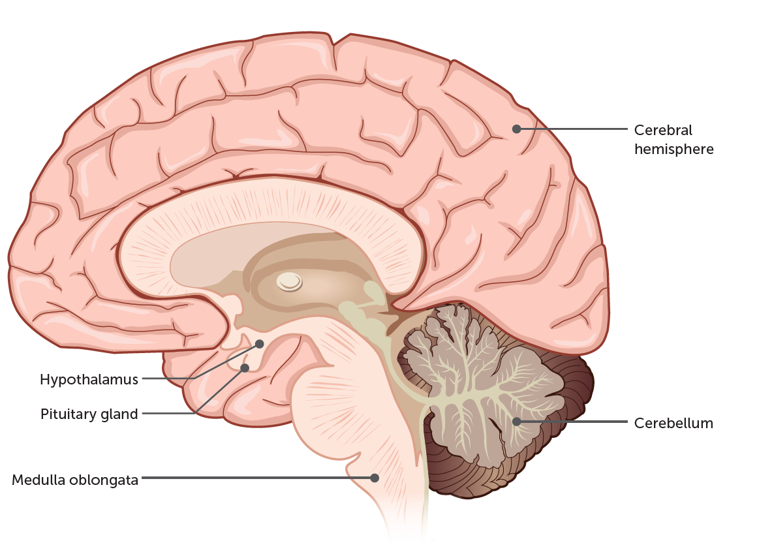
Hypothalamus
The hypothalamus lies in the middle of the brain and cannot be seen from the outside. Although small, the hypothalamus controls many bodily activities, but it is mostly concerned with maintaining a constant internal environment – homeostasis.
The functions of the hypothalamus include the regulation of:
The autonomic nervous system, including the regulation of heart rate, blood pressure, the secretion of digestive juices, movements of the alimentary cars and the diameter of the pupil of the eye.
Body temperature.
Food and water intake.
Patterns of waking and sleeping.
Contraction of the urinary bladder.
Emotional responses such as fear, anger, aggression, pleasure and contentment.
The secretion of hormones and coordination of parts of the endocrine system: acting through the pituitary gland the hypothalamus regulates metabolism, growth, reproduction and responses to stress.

Slide 16
Medulla oblongata
The medulla oblongata is a continuation of the spinal cord it is about 3 cm long and extends from just above the point where the spinal cord enters the skull. Many nerve fibres simply pass through the medulla going to are from the other parts of the brain, but the medulla does have an important role in automatically adjusting body functions.
The medulla oblongata contains:
The cardiac centre, which regulates the rate and force of the heartbeat the vasomotor centre, which regulates the diameter of blood vessels
Respiratory centres, which control rate and depth of breathing
The vasomotor centre, which regulates the diameter of blood vessels.
In addition, other centres regulate the reflexes of swallowing, sneezing, coughing and vomiting. All the centres in the medulla oblongata are influenced and controlled by higher centres in the brain particularly the hypothalamus.

